Slide 1
CREDIT CARD FRAUD DETECTION USING MACHINE LEARNING
Group Members :
Ashish Simhadri(18101047)
Siddhu Banavath(18101007)
Lohith Kumar(18101012)
Mentor :
Dr. Ramakrishna Bandi
(Asst. Professor)

Slide 2
INTRODUCTION
Fraud in credit card transactions is unauthorized and unwanted usage of an account by someone other than the owner of that account.
Fraud detection involves monitoring the activities of populations of users in order to estimate, perceive or avoid objectionable behaviour, which consist of fraud, intrusion and defaulting.
This is a very relevant problem that demands the attention of communities such as machine learning where the solution to this problem is automated.
Machine learning algorithms are employed to analyse all the authorized and report the suspicious ones.

Slide 3
MOTIVATION
It is vital that credit card companies should be able to identify fraudelent credit card transactions so that customers are not charged for items that they did not purchase.
A typical organisation loses 5% of their yearly revenue to frauds. 2480 cases of fraud in 18 public sector banks invloving 31,898 crores.(RTI information)

Slide 4
OBJECTIVE
Creating a Machine Learning Model which can detect Credit Card Fraud Detection Cases

Slide 5
STEPS TO REACH THE OBJECTIVE
Creating a appropriate dataset
We plot different graphs to check for inconcsistencies in the dataset and to visually comprehend it.
We find the fraud transactions through the plots.

Slide 6
LITERATURE REVIEW
A comprehensive survey conducted by Clinton Phua and his associates have revealed that techniques employed in this domain include data mining applications.
A research scholar presented techniques like Supervised and Usupervised Learning for Credit Card Fraud Detection. Even though algorithms fetched an unexpected success in some areas.
A similar research domain was presented by Wen-Fang YU where they used Outlier mining and Distance sum algorithm to accurately predict fraudulent transaction.

Slide 7
CREATING AN APPROPRIATE DATASET
We have obtained our dataset for the fraud detection in a CSV format.
The dataset is a BigQuery table.
The dataset consists of 31 columns.
The first column is 'Time' - Number of seconds elapsed between this transaction and the first transaction in the dataset.
The next 28 columns are 'V1 - V28' - Maybe result of a PCA dimensionality reduction to protect user identities and sensitive features. The other 2 columns are Amount and Class.
References :
https://www.kaggle.com/mlg-ulb/creditcardfraud

Slide 8
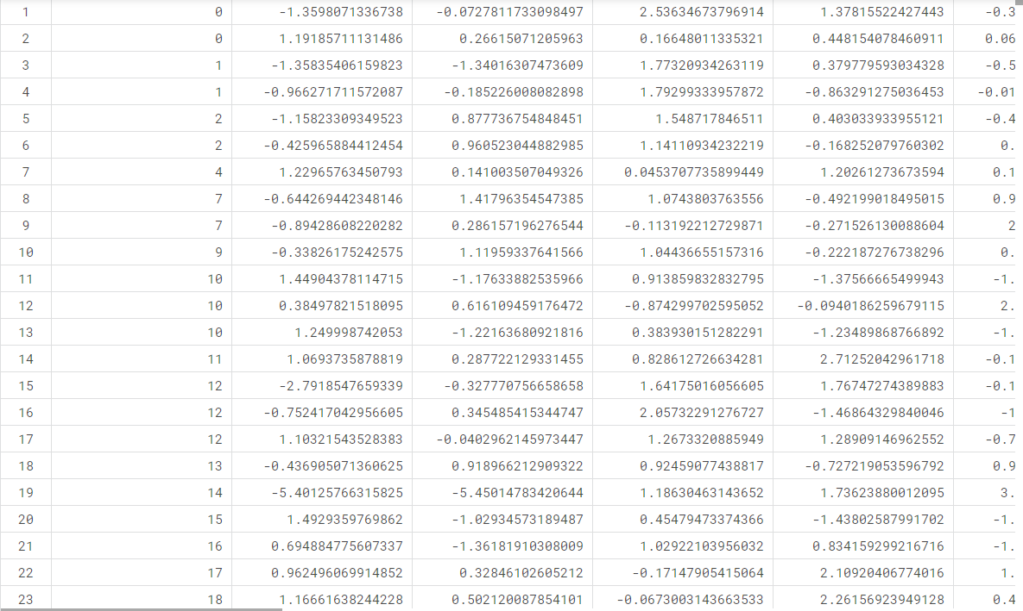
DATA SET

Slide 9
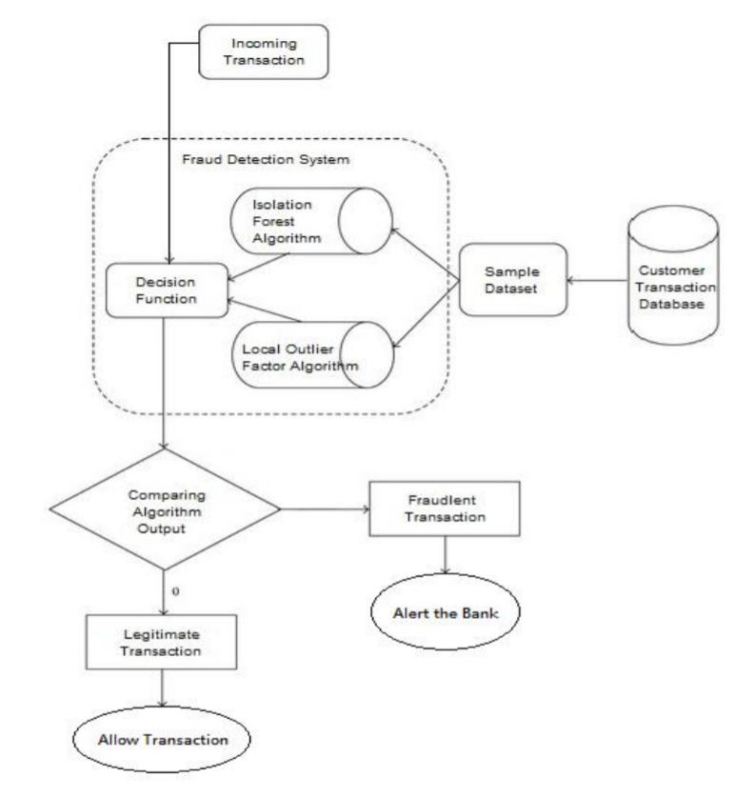
IMPLEMENTATION MODEL

Slide 10
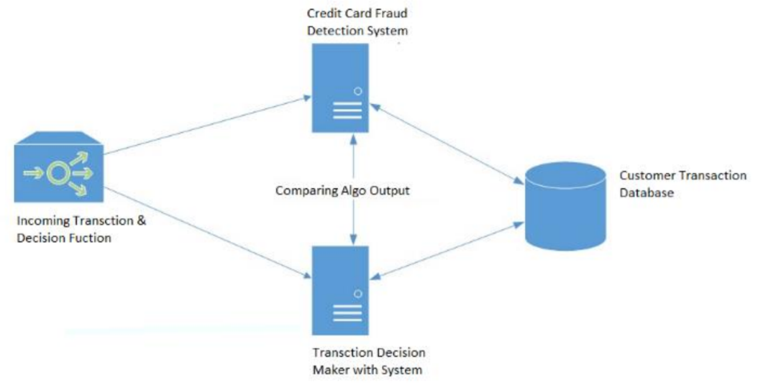
METHODOLOGY
The approach that this model proposes, uses the latest machine learning algorithms to detect anamolous activities, called outliers.
The basic rough architecture diagram can be represented with the following figure :

Slide 11
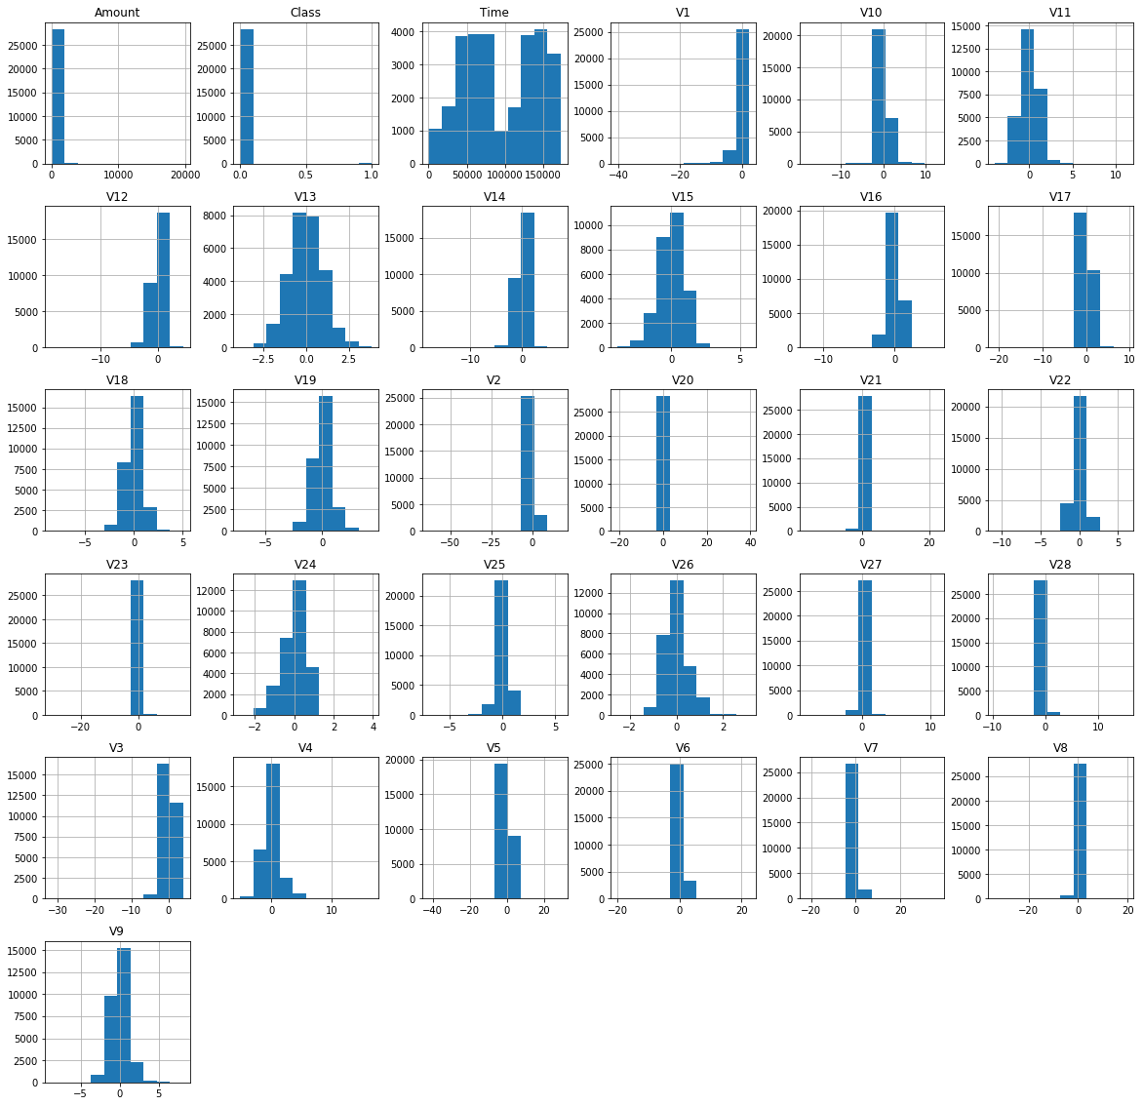
VISUALISATION OF DATA IN HISTOGRAM

Slide 12
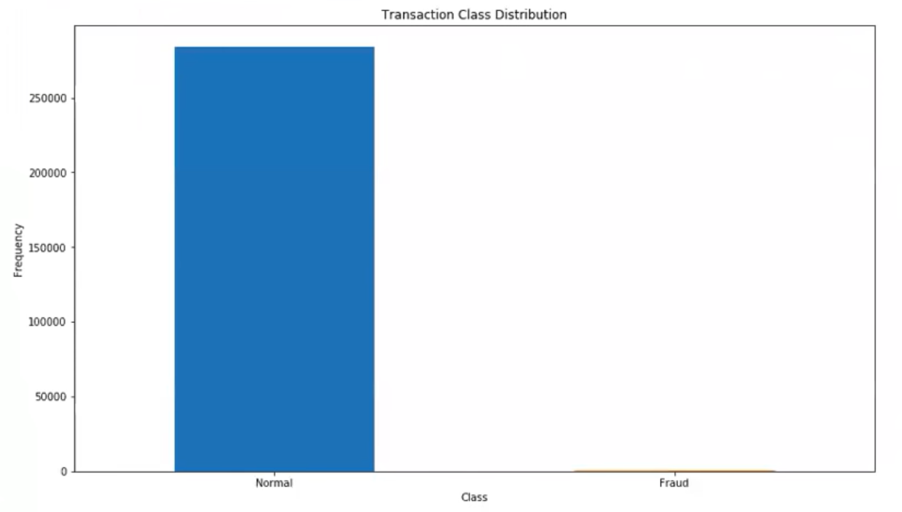
PLOTS
This graph shows that the number of fraudulent transactions is much lower than the legitimate ones.

Slide 13
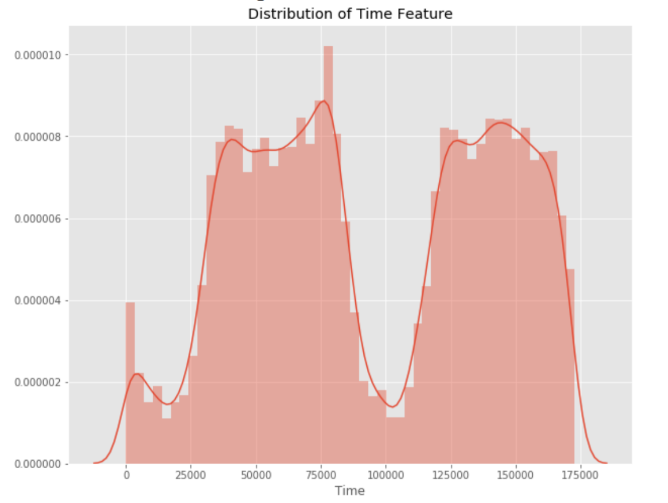
PLOTS
This graph shows the times at which transactions were done within two days. It can be seen that the least number of transactions were made during night time and highest during the days.

Slide 14
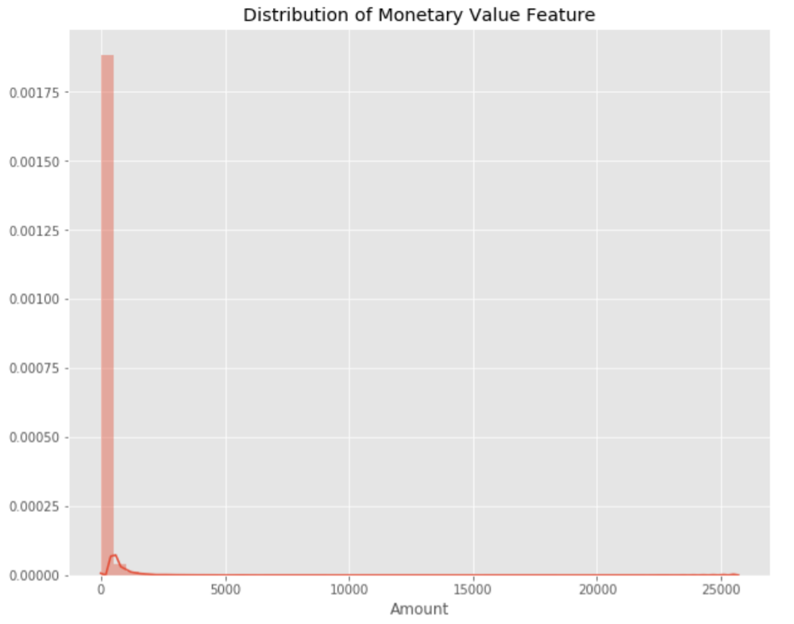
PLOTS
This graph represents the amount that was transacted. A majority of transactions are relatively small and only a handful of them come close to the maximum transacted amount.

Slide 15
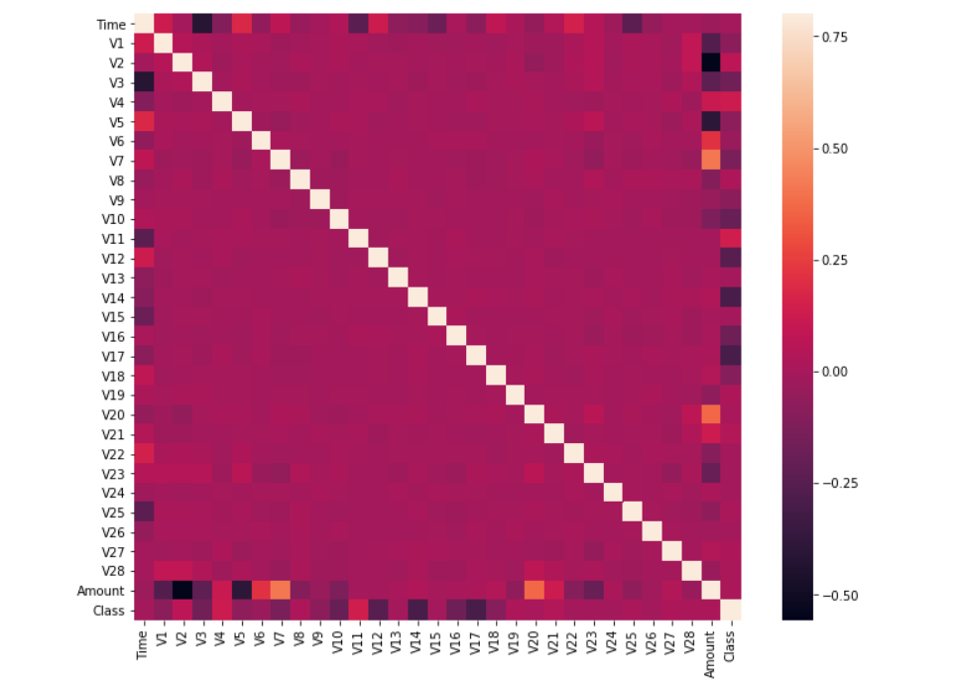
VISUALISATION OF HEATMAP
We plot a heatmap to get a coloured representation of the data and to study the correlation between out predicting variables and the class variable.

Slide 16
METHODOLOGY
The dataset is now formatted and processed. The time and amount column are standardized and the Class column is removed to ensure fairness of evaluation. The data is processed by a set of algorithms from modules. This data is fit into a model and the following outlier detection modules are applied on it. The algorithms are,
1) Local Outlier Factor
2) Isolation Forest Algorithm
These algorithms are a part of sklearn. The ensemble module in the sklearn package includes ensemble-based methods and functions for the classification, regression and outlier detection.

Slide 17
LOCAL OUTLIER FACTOR
It is an Unsupervised Outlier Detection algorithm. 'Local Outlier Factor' refers to the anomaly score of each sample. It measures the local deviation of the sample data with respect to its neighbours. More precisely, locality is given by k-nearest neighbours, whose distance is used to estimate the local data.

Slide 18
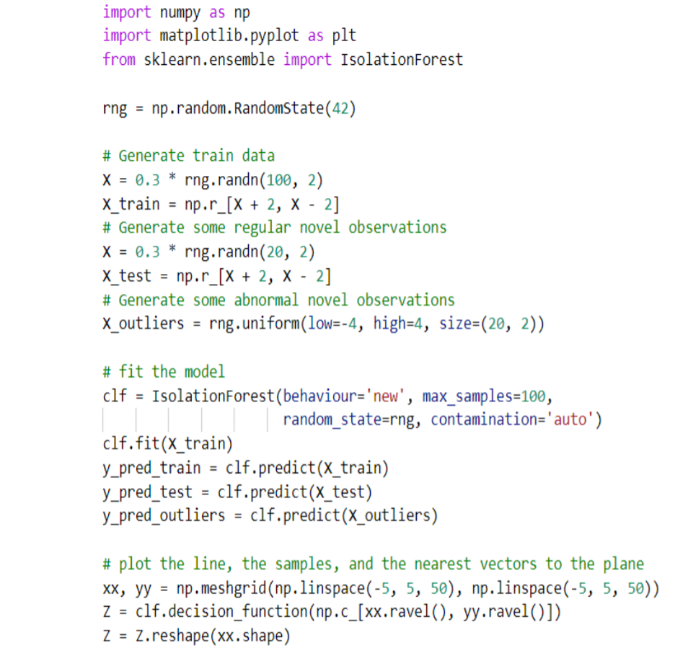
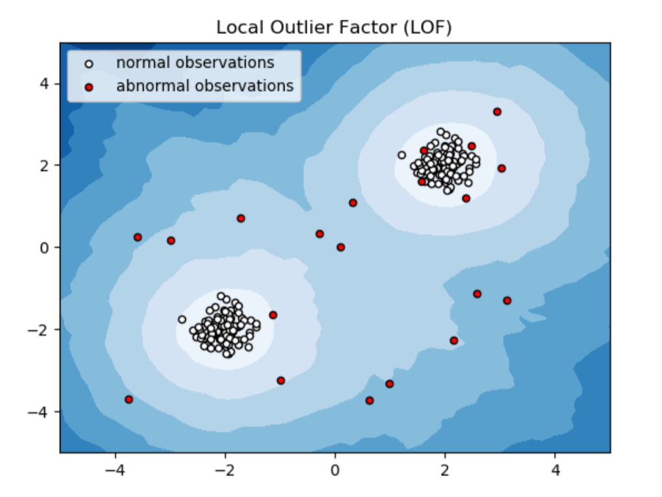
PSEUDO CODE FOR LOCAL OUTLIER FACTOR
The pseudo code for this algorithm is :
The result of the algorithm is :

Slide 19
LOCAL OUTLIER FACTOR
By comparing the local values of a sample to that of its neighbours, one can identify samples that are substantially lower than their neighbours. These values are quite amanous and they are considered as outliers.

Slide 20
ISOLATION FOREST ALGORITHM
The Isolation Forest ‘isolates’ observations by arbitrarily selecting a feature and then randomly selecting a split value between the maximum and minimum values of the designated feature. Recursive partitioning can be represented by a tree, the number of splits required to isolate a sample is equivalent to the path length root node to terminating node. The average of this path length gives a measure of normality and the decision function which we use.

Slide 21
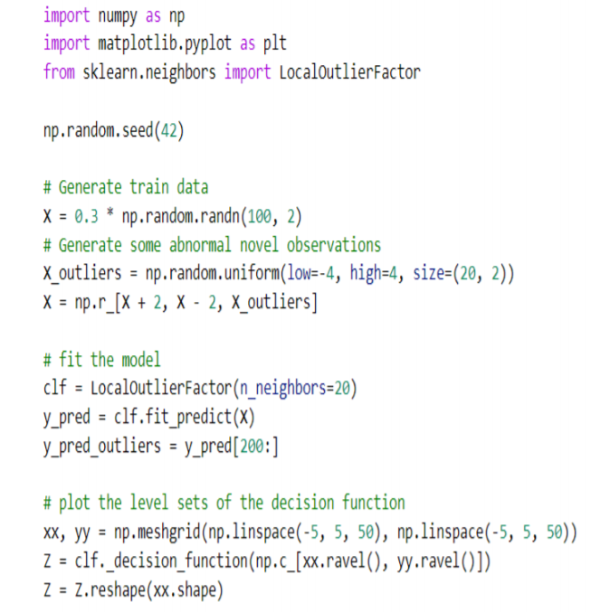
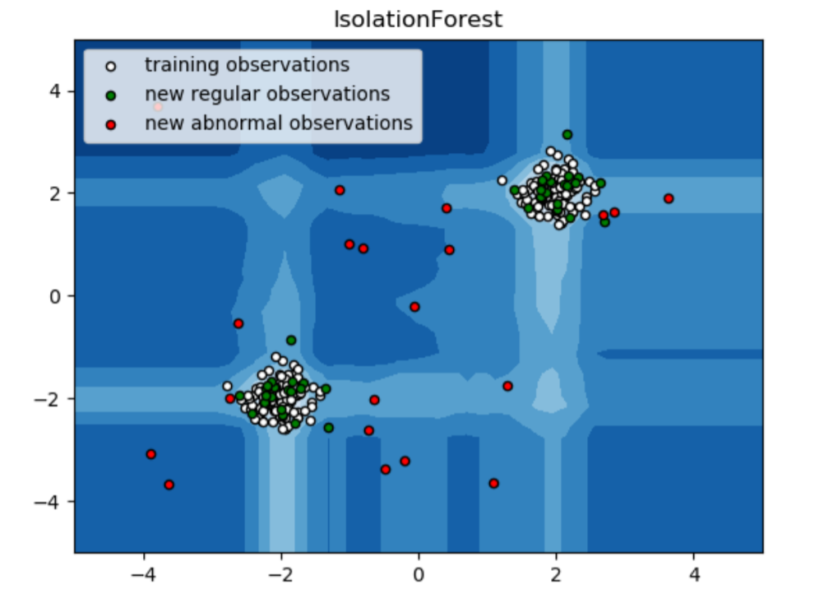
PSEUDO CODE FOR ISOLATION FOREST ALGORITHM
The pseudo code for this algorithm is :
The result of the algorithm is :

Slide 22
ISOLATION FOREST ALGORITHM
Partitioning them randomly produces shorter paths for anomalies. When a forest of random trees mutually produces shorter path lengths for specific samples, they are extremely likely to be anomalies. Once the anomalies are detected, the system can be used to report them to the concerned authorities. For testing purposes, we are comparing the outputs of these algorithms to determine their accuracy and precision.

Slide 23
CONCLUSION
Credit card fraud is without a doubt an act of criminal dishonesty. With this model we could be able to explain in detail, how machine learning can be applied to get better results in fraud detection along with the algorithm, pseudocode, explanation its implementation and experimentation results. The algorithm does reach over 99.6% accuracy and the precision rises to 33%. This high percentage of accuracy is to be expected due to the huge imbalance between the number of valid and number of genuine transactions.

Slide 24
FUTURE ENHANCEMENTS
As we found out the apt algorithms which give a high acuuracy and precision and those algorithms are Local Outlier Factor and Isolation Forest Algorithm, by using these we will detect the fraud cases in detail by plotting the graphs and identify those fraud points present in the dataset. We use sklearn packages to implement these algorithms.

Slide 25
REFERENCES
CLIFTON PHUA1, VINCENT LEE1, KATE SMITH1 & ROSS GAYLER2 “ A Comprehensive Survey of Data Mining-based Fraud Detection Research” published by School of Business Systems, Faculty of Information Technology, Monash University, Wellington Road, Clayton, Victoria 3800, Australia
“Survey Paper on Credit Card Fraud Detection by Suman” , Research Scholar, GJUS&T Hisar HCE, Sonepat published by International Journal of Advanced Research in Computer Engineering & Technology(IJARCET) Volume 3 Issue 3, March 2014
“Research on Credit Card Fraud Detection Model Based on Distance Sum – by Wen-Fang YU and Na Wang” published by 2009 International Joint Conference on Artificial Intelligence

